Slide 1
Solar Power Forecasting Using Machine Learning
Predicting DC Power Generation with XGBoost
Presented by: Donn Bryan Julian

Slide 2
Outline
Executive Summary
Introduction
Data Collection and Wrangling
Methodology
Exploratory Data Analysis (EDA)
Feature Engineering
Model Selection
Hyperparameter Tuning
Cross-Validation
Results
Model Performance
Feature Importance
Conclusion
Appendix

Slide 3
Executive Summary
Objective:
Predict solar power generation using machine learning techniques to optimize energy production efficiency.
Key Findings:
Best Model: XGBoost, with a final R² of 0.9608 and MSE of 631,631.
Feature Importance: AMBIENT_TEMPERATURE and DAILY_YIELD were the most critical predictors.
Cross-Validation: The model performed well with a mean cross-validation MSE of 706,671, confirming its robustness.
Outcome:
The model provides reliable forecasts for solar power generation, suitable for real-time use.

Slide 4
Introduction
Project Goal:
To forecast DC power generation using environmental factors like temperature and solar radiation.
Why Solar Power Forecasting?:
Improves energy distribution and grid management.
Optimizes solar power plant operations, minimizing energy waste.
Data Used:
Data Source: Solar Power Generation Data
Why Focus on Plant 1?: Plant 2 had inconsistent data with lower correlation to DC_POWER, reducing its predictive power.

Slide 5
Data Collection and Wrangling
Step-by-Step Process
Data Collection:
Source: Solar Power Generation Data from Kaggle.
Data Structure: The dataset contains records from two solar plants, each with variables such as DC_POWER, AC_POWER, AMBIENT_TEMPERATURE, and IRRADIATION.
Reason for Focusing on Plant 1: Plant 2 had inconsistent and lower-quality data, leading to unreliable predictions, so we excluded it to ensure accuracy and reliability.
ETL Process Flowchart: Solar Power Generation Data
Extract: Load dataset from Kaggle
↓
Check for missing values, duplicates, and outliers
Transform:
Remove irrelevant columns (e.g., AC_POWER)
↓
Feature engineering (add lagged variables for DAILY_YIELD and TOTAL_YIELD)
↓
Normalize continuous variables (e.g., AMBIENT_TEMPERATURE, IRRADIATION)
Load:
Prepare cleaned and transformed data for modeling
↓
Validate data quality and confirm readiness for analysis

Slide 6
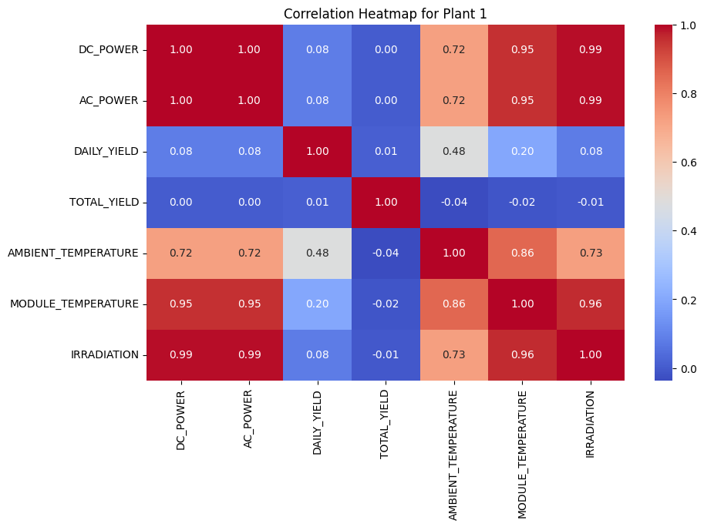
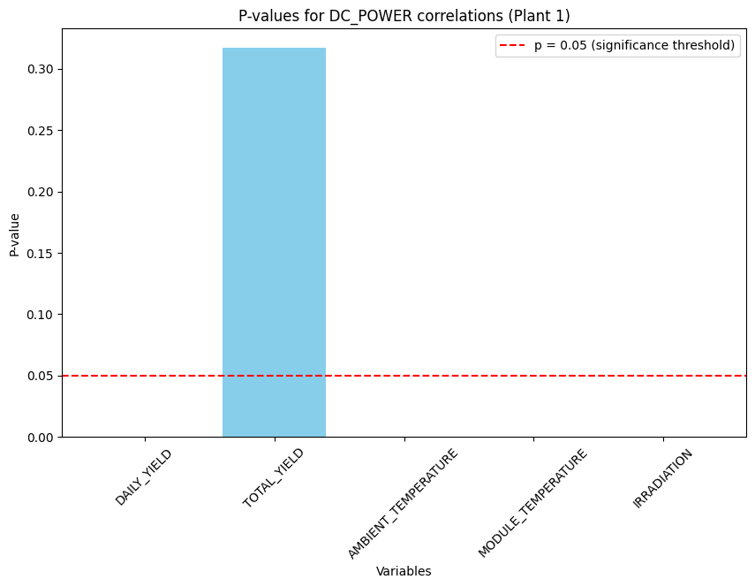

Slide 7
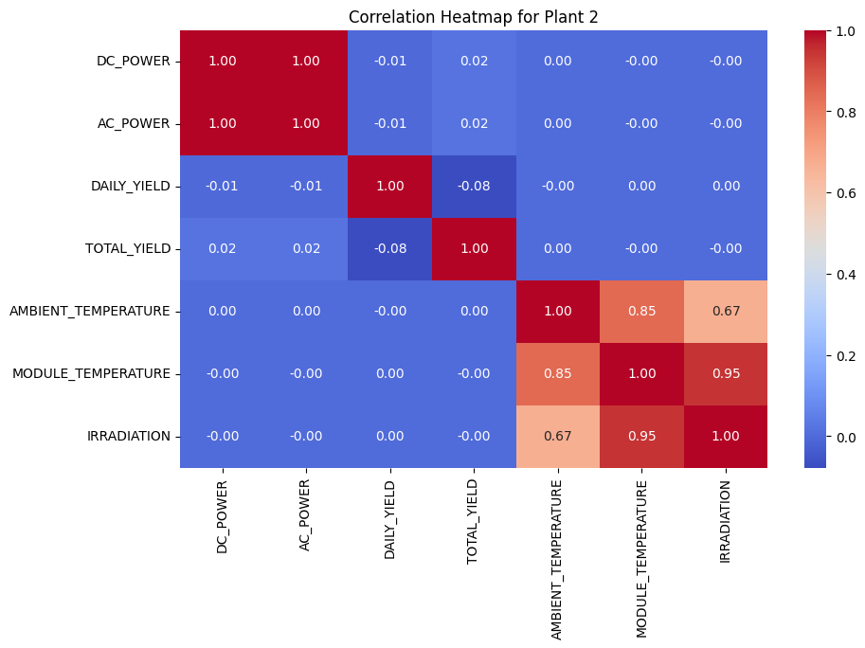
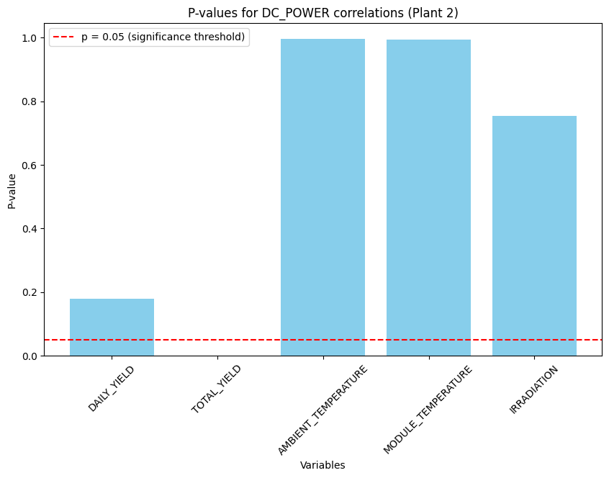

Slide 8
Data Wrangling:
Missing Values: While the dataset had no missing values, we ran validation checks to confirm data quality.
Feature Selection: Focused on key features like DAILY_YIELD, TOTAL_YIELD, and temperature-related metrics, which showed high relevance to DC_POWER.
Reasoning for Removing AC_POWER: It showed weak correlation with DC_POWER, which justified its exclusion to reduce model complexity.

Slide 9
Variables Used in the Model
Key Variables
Target Variable:
DC_POWER: The model predicts this based on other features.
Predictor Variables:
DAILY_YIELD: Daily energy output.
TOTAL_YIELD: Cumulative energy produced.
AMBIENT_TEMPERATURE: External temperature affecting efficiency.
MODULE_TEMPERATURE: Solar panel temperature.
IRRADIATION: Solar radiation received.
Lagged Variables: Added DAILY_YIELD_LAG1, TOTAL_YIELD_LAG1 to enhance time-series prediction.

Slide 10
Methodology - EDA & Feature Engineering
Exploratory Data Analysis (EDA):
Correlation Heatmaps: Revealed strong relationships between features and the target variable DC_POWER, particularly for temperature and irradiation.
Multicollinearity Check: Handled through variance inflation factor (VIF), ensuring no multicollinearity issues in the features.
Feature Engineering:
Reasoning: Added lagged features to capture time-series behavior in solar power generation. This helps the model account for temporal patterns.

Slide 11
Methodology - Model Diagnostics
Model Diagnostics and Assumption Testing:
Breusch-Pagan Test for Heteroskedasticity:
Ensures constant variance in residuals, which is essential for accurate predictions.
Result: The Breusch-Pagan p-value was extremely small (4.99e-304), indicating the presence of heteroskedasticity. To address this, heteroscedasticity-robust standard errors were used.
Variance Inflation Factor (VIF) for Multicollinearity:
Measures collinearity among predictor variables. High VIF values indicate problematic multicollinearity.
Result:
DAILY_YIELD and TOTAL_YIELD had acceptable VIF scores (<5), indicating low multicollinearity.
AMBIENT_TEMPERATURE, MODULE_TEMPERATURE, and IRRADIATION had high VIF scores, with MODULE_TEMPERATURE and IRRADIATION being the most problematic (VIF > 10). Multicollinearity needed attention.
Durbin-Watson Test for Autocorrelation:
Checks if residuals are independent. A value close to 2 indicates no autocorrelation.
Result: The Durbin-Watson statistic was 1.32, which suggests slight positive autocorrelation in the residuals.

Slide 12
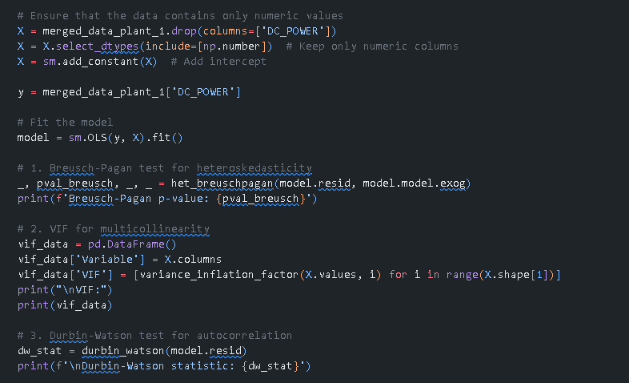
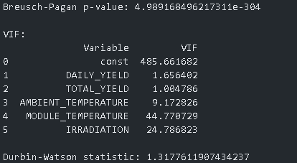

Slide 13
Methodology - Model Refinement
Model Refinement and Feature Engineering:
Handling Multicollinearity:
Removed MODULE_TEMPERATURE and IRRADIATION due to high VIF values, indicating strong multicollinearity.
Rationale: Keeping multicollinear features would distort the model, so eliminating them improved clarity in feature impact.
Introduction of Lagged Variables:
Added a lagged feature (DAILY_YIELD_LAG1) to capture temporal effects on DC_POWER.
Rationale: Lagged variables help improve the model by considering the impact of past energy yields on current power generation.
Revised Model Fit:
After making these changes, the model was refitted using heteroscedasticity-robust standard errors to account for any residual heteroskedasticity.
Visual Representation: A plot of residuals after adding lagged variables shows improved consistency.

Slide 14
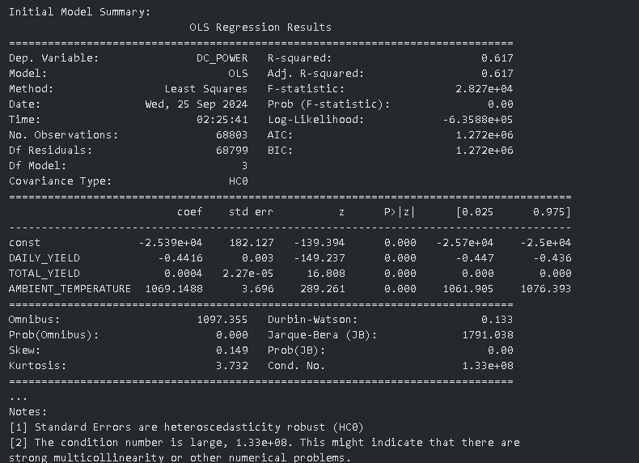
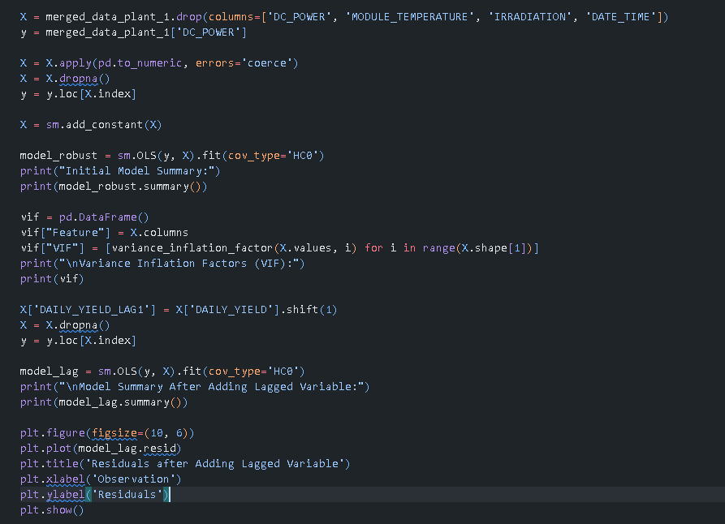
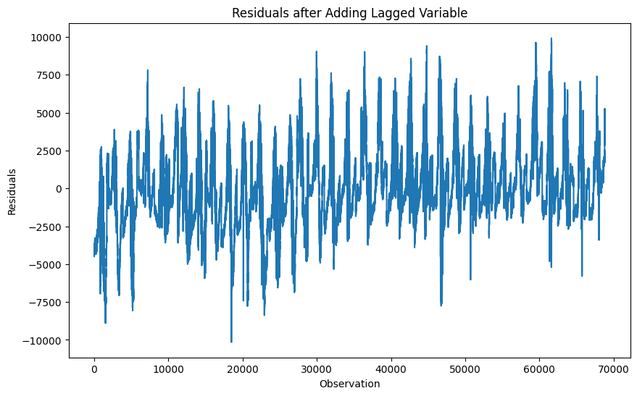

Slide 15
Methodology - Residual Analysis
Residual Diagnostics for Final Model:
Residual Analysis:
Analyzed the residuals of the final ARIMA model to ensure they follow a normal distribution and do not exhibit patterns over time.
Why: Checking residuals ensures that the model assumptions of independence, homoscedasticity, and normality hold, which is crucial for accurate forecasting.
Autocorrelation Function (ACF) and Partial Autocorrelation Function (PACF):
The ACF and PACF plots help detect autocorrelation in the residuals, which could indicate that the model hasn’t captured all the information in the data.
Why: Residuals should ideally have no significant autocorrelation, confirming the model is well-specified.
Normality Check (Q-Q Plot and Jarque-Bera Test):
Used a Q-Q plot and performed the Jarque-Bera test to assess whether residuals are normally distributed.
Result: (Include Jarque-Bera result to explain if the residuals follow a normal distribution.)
Why: Normality of residuals helps validate that the model is reliable and robust for inference.

Slide 16
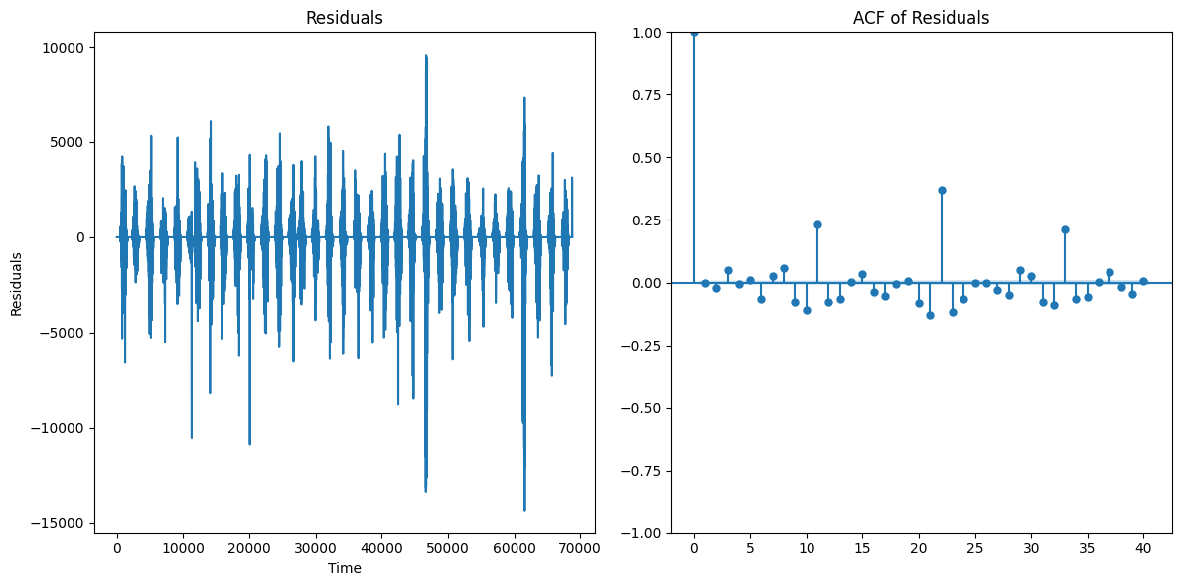

Slide 17
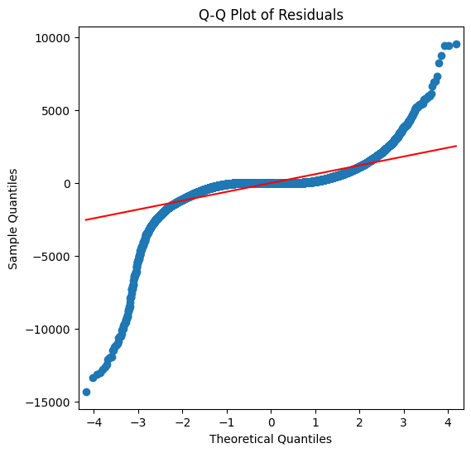

Slide 18
Methodology - Model Refinement (Lagged Variables)
Introducing Lagged Variables:
Feature Engineering:
Added lagged variables for DAILY_YIELD and TOTAL_YIELD to capture temporal dependencies in the data.
Why: Energy production often depends on past values, so incorporating lagged variables helps improve predictive power by capturing these relationships.
Model Refinement:
Refit the model with the newly added lagged variables.
Why: The addition of lagged variables aims to improve the model's ability to predict DC_POWER by considering past values of key features.
Residual Diagnostics After Lagging:
Residuals with Lagged Variables:
Residuals were analyzed again to check for patterns after adding the lagged variables.
Why: It’s essential to ensure that adding lagged variables improves the model's performance without introducing new issues like autocorrelation.
Autocorrelation Check (ACF):
ACF plot of residuals was used to confirm whether autocorrelation was still present.
Why: Ideally, residuals should have no significant autocorrelation, confirming that the model captures the data well.

Slide 19
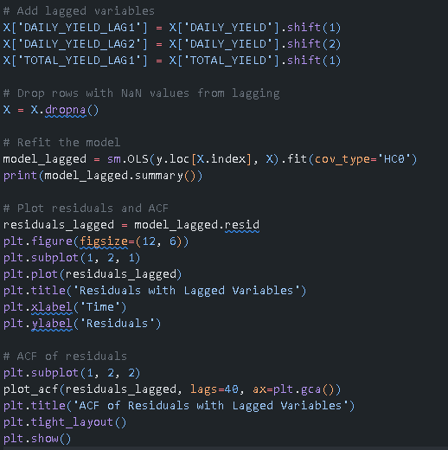
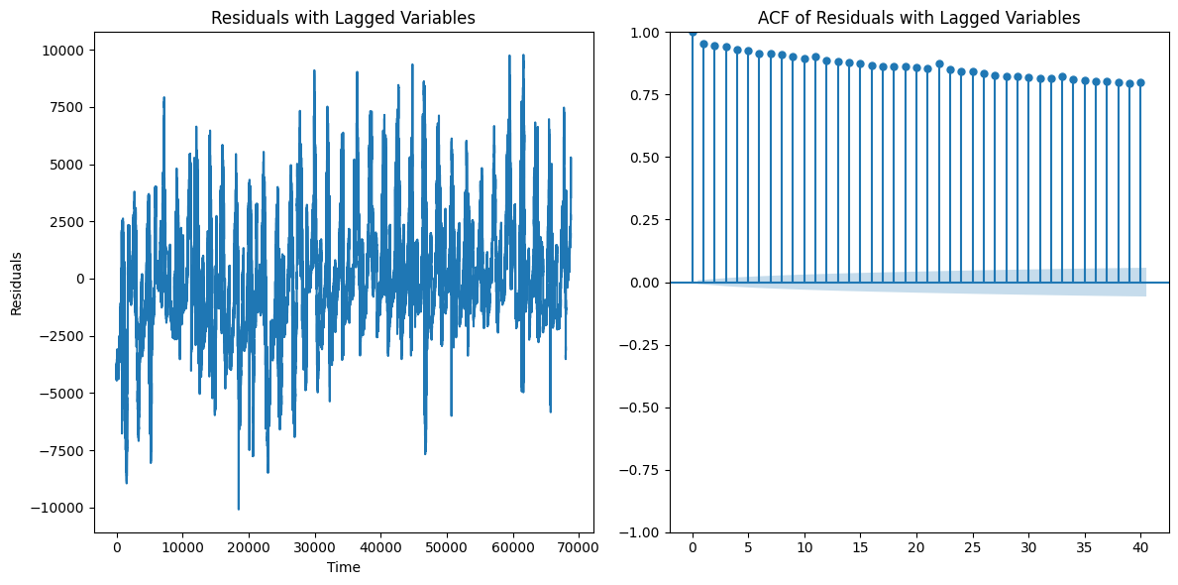

Slide 20
Methodology - Model Selection
Models Tested:
Random Forest
Gradient Boosting
XGBoost
Support Vector Machines
Linear Regression
Selection Criteria:
Mean Squared Error (MSE): Measures prediction accuracy.
R-squared: Measures how well the model explains the variance in DC_POWER.
Best Model: XGBoost performed the best, providing a balance between accuracy and computational efficiency.

Slide 21
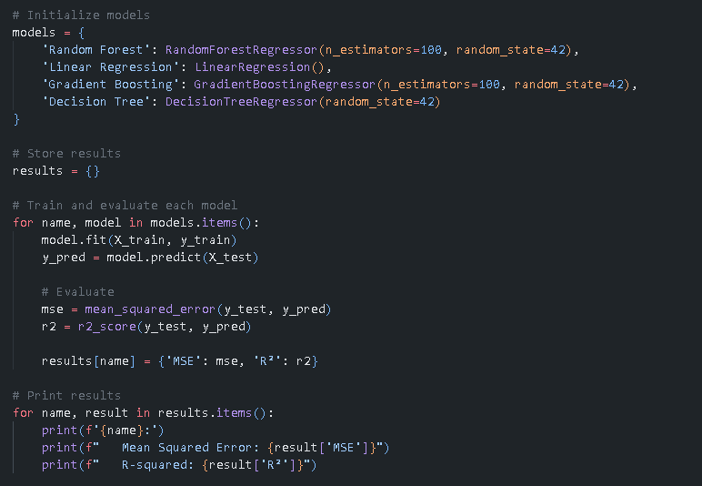
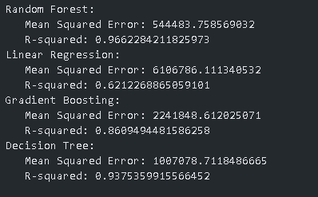

Slide 22
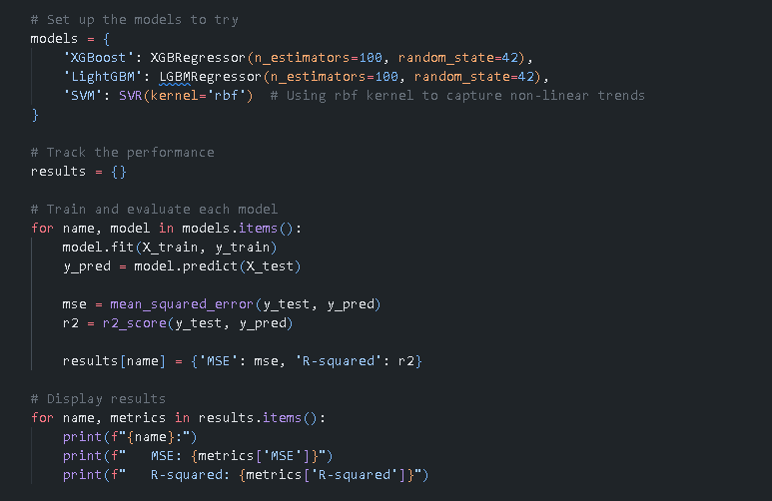
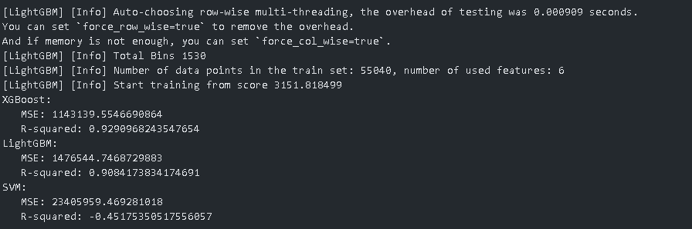

Slide 23
Why We Chose XGBoost Over Random Forest
1. Performance and Speed:
XGBoost is optimized for speed and performance, using gradient boosting to iteratively improve predictions.
Faster and more efficient for large datasets compared to Random Forest.
2. Built-in Regularization:
XGBoost incorporates L1 and L2 regularization, which helps prevent overfitting by penalizing model complexity.
Random Forest lacks this built-in feature, making XGBoost more robust when overfitting is a concern.
3. Handling Imbalanced Data:
XGBoost provides parameters like scale_pos_weight to better manage imbalanced datasets.
This improves the model’s performance on datasets where one class dominates.
4. Advanced Hyperparameter Tuning:
XGBoost offers more customization and tuning options (e.g., learning_rate, max_depth, n_estimators).
These options allow for a more refined and optimized model compared to Random Forest.
5. Cross-Validation and Early Stopping:
XGBoost includes early stopping to halt training when performance stops improving, avoiding overfitting.
Random Forest doesn’t have this built-in functionality, requiring more manual checks.
6. Handling Missing Data:
XGBoost can handle missing values automatically by learning how to manage missing data points.
Random Forest requires more manual data preprocessing to handle missing data effectively.

Slide 24
Methodology - Hyperparameter Tuning
Why Tuning?:
Avoiding Overfitting: Hyperparameter tuning helps prevent the model from becoming too complex.
Improving Accuracy: Tuned parameters like max_depth, learning_rate, and n_estimators led to a significant performance boost.
Tuned XGBoost Parameters:
Max Depth: 10, Learning Rate: 0.1, Estimators: 500, Subsample: 0.8.

Slide 25
Hyperparameter Tuning with GridSearchCV
Tuning XGBoost for Optimal Performance
Why: Tuning hyperparameters allows us to optimize the model's performance by finding the best combination of parameters that minimize error.
Steps Taken:
Grid Search:
We defined a parameter grid that included different values for n_estimators, max_depth, learning_rate, subsample, and colsample_bytree.
Why: These parameters control how the XGBoost model grows decision trees and combines them. By systematically testing combinations, we find the most effective setup.
Cross-Validation:
Applied 3-fold cross-validation within the grid search to ensure the model performs well across different data splits.
Why: Cross-validation reduces the risk of overfitting by evaluating the model on multiple training/validation splits.
Results:
Best Parameters: {'colsample_bytree': 0.8, 'learning_rate': 0.1, 'max_depth': 10, 'n_estimators': 500, 'subsample': 0.8}
These were the parameters that minimized the mean squared error (MSE) across the training data.
Test Set Evaluation:
After tuning, the final model was evaluated on the test set:
Tuned XGBoost MSE: 631631.9427001182
Tuned XGBoost R-squared: R-squared: 0.9608230592726087Conclusion:
Why Tuning Matters: The hyperparameter tuning process helped improve the model’s performance by finding the best parameter configuration.

Slide 26
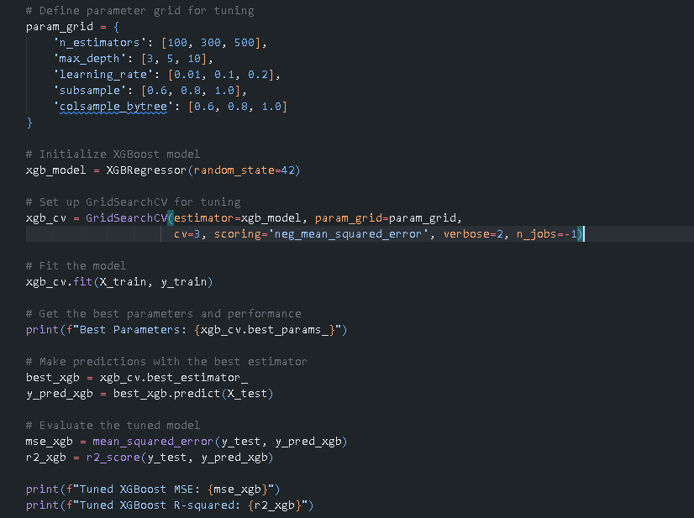

Slide 27
Methodology - Cross-Validation
Why Cross-Validation?:
Reasoning: Ensures the model’s generalizability by testing its performance on multiple splits of the data.
Cross-Validation Results:
Mean MSE: 706,671.
Consistency: The model performed well across all data splits, confirming its robustness.

Slide 28
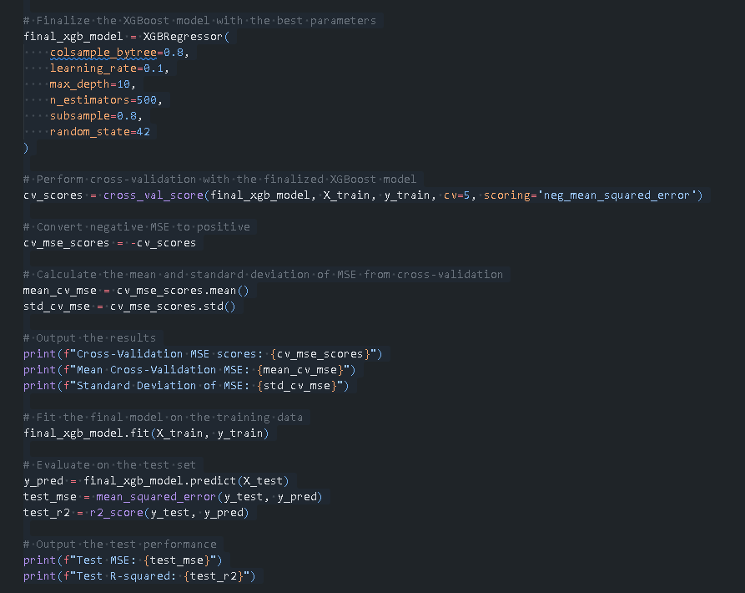
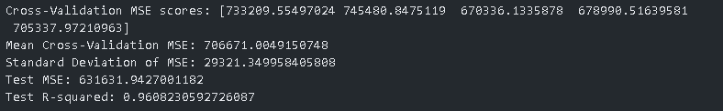

Slide 29
Results - Feature Importance
Top Features:
AMBIENT_TEMPERATURE: Most important predictor of solar power generation.
DAILY_YIELD: Also highly important, capturing the day-to-day variation in energy production.
Lagged Variables: Contributed significantly to improving model accuracy.
Why We Kept All Features:
Removing low-importance features led to a drop in performance, so they were retained.

Slide 30
Results - Model Performance
Final Model Performance (XGBoost):
Test Set MSE: 631,631.
R-squared: 0.9608, indicating that the model explained 96% of the variance in DC_POWER.
Cross-Validation:
Consistently low MSE values across different data splits confirmed the model’s robustness.

Slide 31
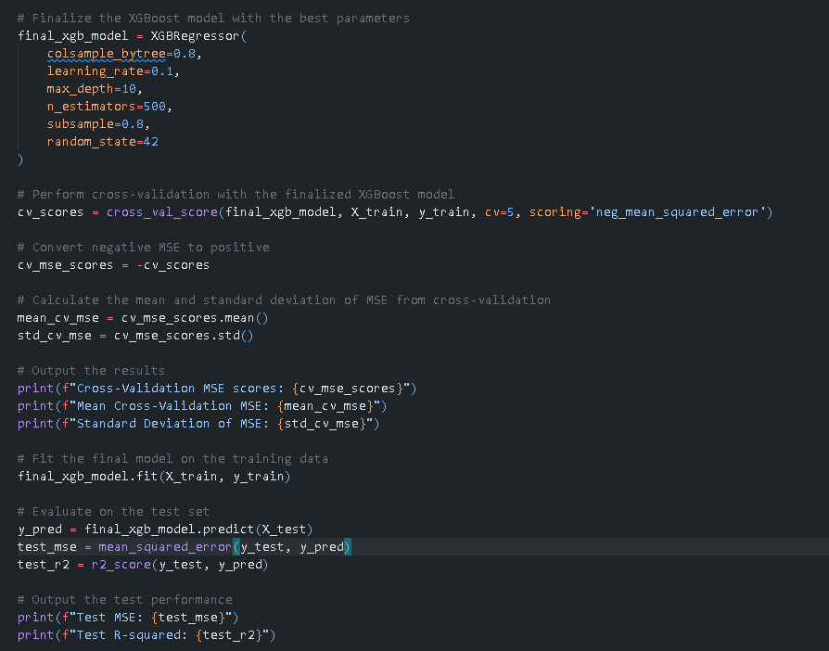
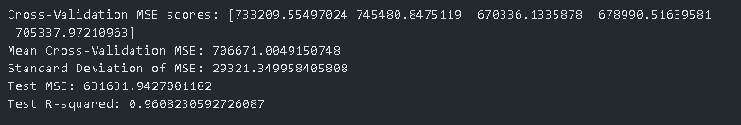

Slide 32
Visualizations
Actual vs Predicted Plot:
Interpretation: The plot shows a close alignment between the actual and predicted values, indicating strong model performance.
Residual Plot:
Interpretation: The residuals are evenly distributed around zero, which means the model is making accurate predictions without systematic errors.

Slide 33
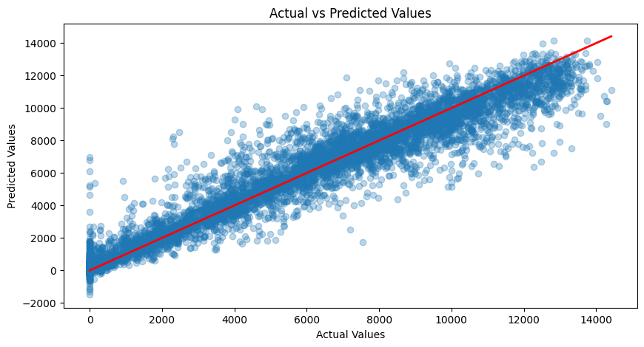
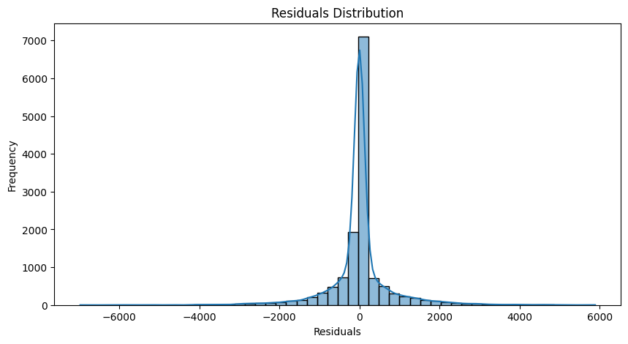

Slide 34
Conclusion
Summary:
The XGBoost model provided accurate predictions with low error rates.
Feature Engineering and Hyperparameter Tuning were key to improving model performance.
Lagged Variables and temperature factors played a crucial role in predictive accuracy.
Challenges:
Removing Plant 2 due to data inconsistencies.
Handling multicollinearity and ensuring data quality were critical steps.
Next Steps:
Deploy the model for real-time solar power forecasting.
Integrate weather forecasting data to further improve accuracy.

Slide 35
Appendix
Additional Visuals:
Heatmaps, feature importance plots, and residual analysis.
Hyperparameter Tuning Details: Full tuning process for XGBoost and other models.
Data Source: Solar Power Generation Data.

Slide 36
